Slide 1
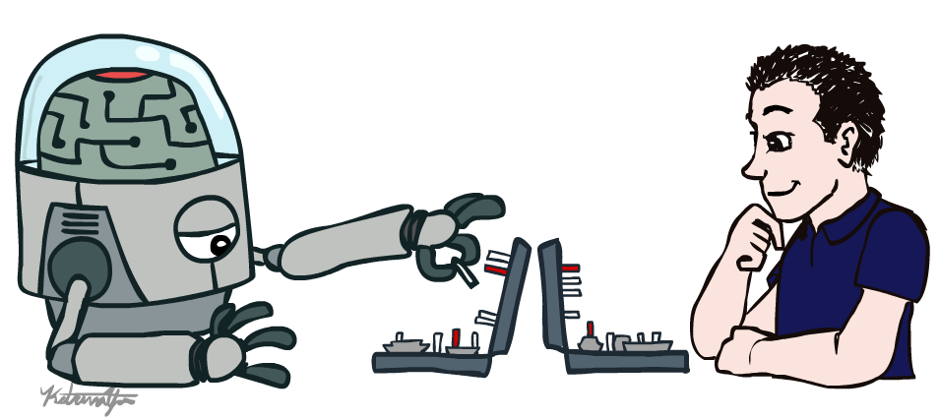
Introduction to Artificial Intelligence
Prof. Guang Cheng Director of Trustworthy AI Lab UCLA

Slide 2
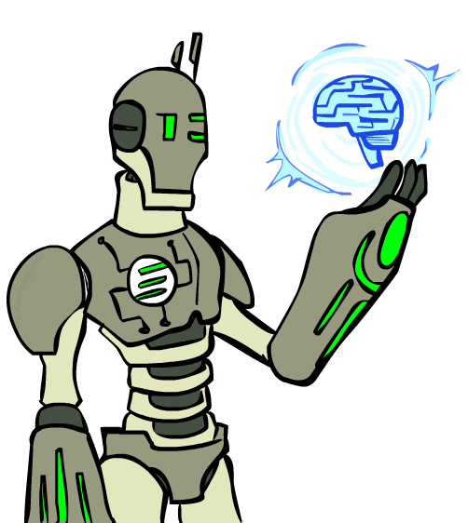
Goals
What is artificial intelligence?
What can AI do?
What will you learn later?

Slide 3
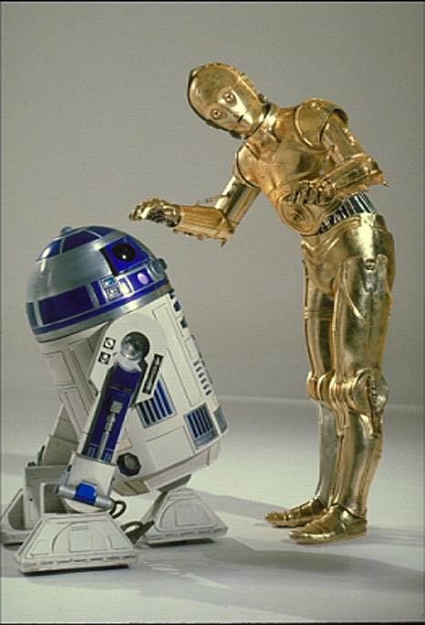
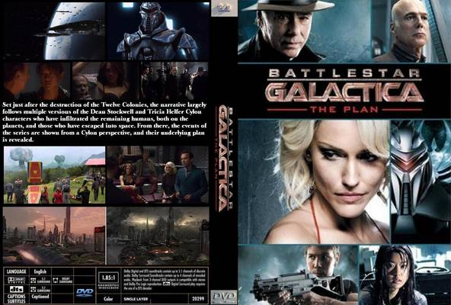
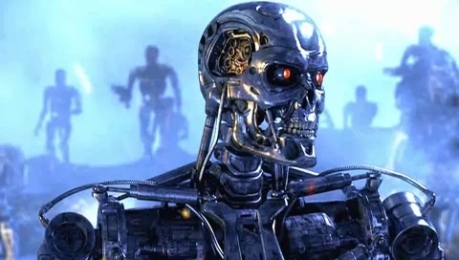
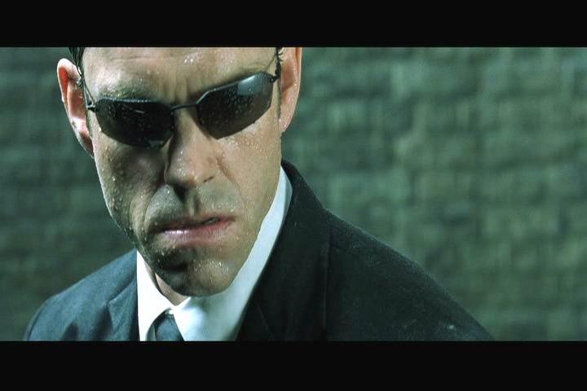
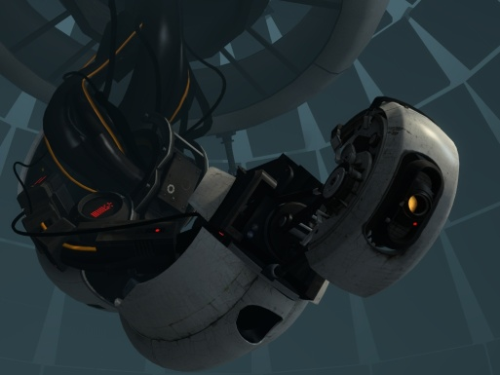
Sci-Fi AI?
Notes:
Who are these? C3PO, what does he do? Essentially google translate, (but with anxiety disorder!)
Smal guy? R2D2 – what does he do, yeah, not so sure
Things got darker: machines come back from the future – to kill us!
90’s : software is scary
Basic fear about what technology might do ?
What if we can’t even tell technology apart from ourselves?
OR maybe it’ll look really different and snarky
Some exceptions like wall-E, positive view of technology (but maybe not of us humans!)
But mostly a worry
[not very worried myself, at least at present]

Slide 4
The AI is about to make “Rational Decisions”
We’ll use the term rational in a very specific, technical way:
Rational: maximally achieving pre-defined goals
Rationality only concerns what decisions are made
(not the thought process behind them)
Goals are expressed in terms of the utility of outcomes
Being rational means maximizing your expected utility
A better title for this course would be:
Computational Rationality
Notes:
Example of utilities. 10 for A, 1 for each Friday with friends

Slide 5
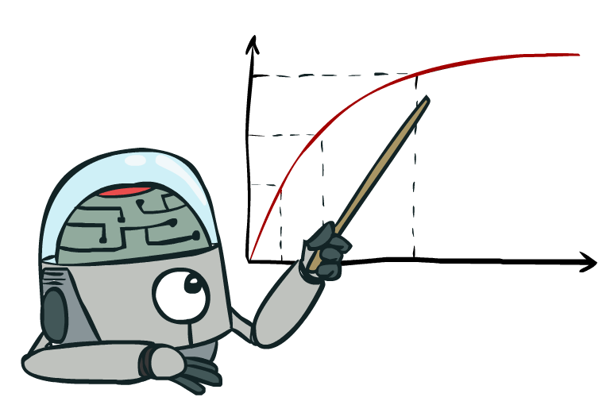
Maximize Your
Expected Utility

Slide 6
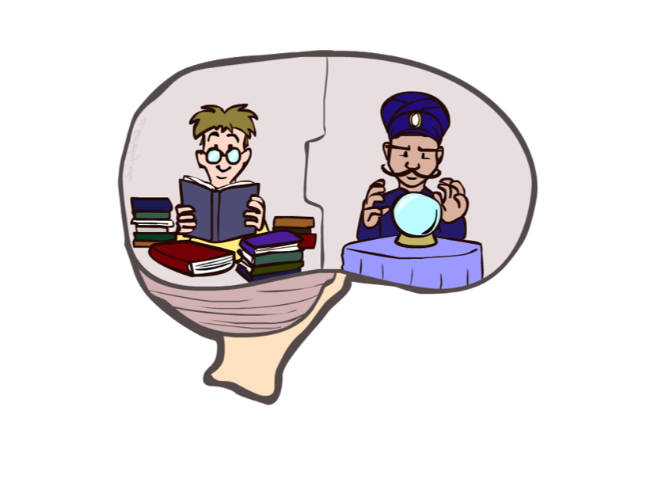
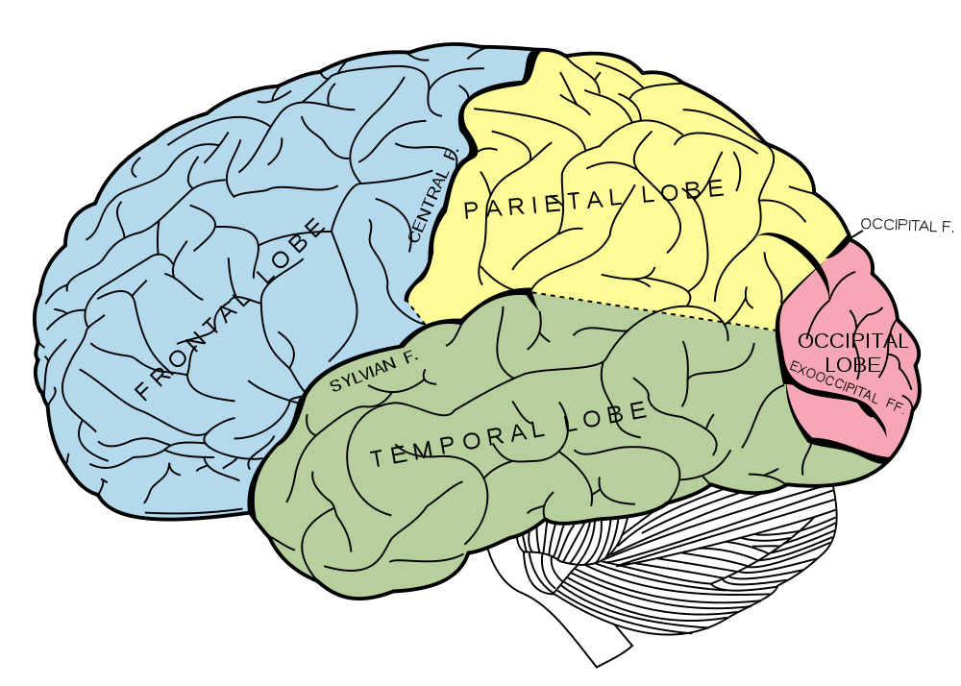
What About the Brain?
Brains (human minds) are very good at making rational decisions, but not perfect
Brains aren’t as modular as software, so hard to reverse engineer!
“Brains are to intelligence as wings are to flight”
Lessons learned from the brain: memory and simulation are key to decision making

Slide 7
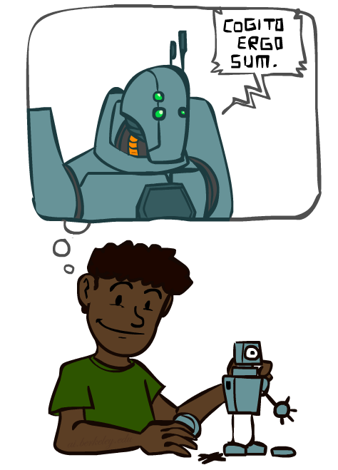
A (Short) History of AI
Demo: HISTORY – MT1950.wmv

Slide 8
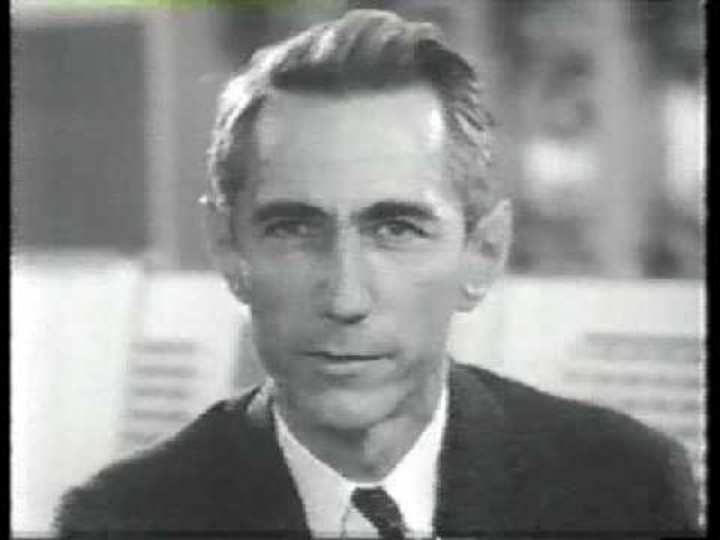
The Thinking Machine
Back in 1960s, did people believe machines can really think? Here is a series of interviews to some of the AI pioneers, Jerome Wiesner, Oliver Selfridge, and Claude Shannon. A view at the future of computer intelligence from back then…

Slide 9
A (Short) History of AI
1940-1950: Early days
1943: McCulloch & Pitts: Boolean circuit model of brain
1950: Turing's “Computing Machinery and Intelligence”
1950—70: Excitement: Look, Ma, no hands!
1950s: Early AI programs, including Samuel's checkers program, Newell & Simon's Logic Theorist, Gelernter's Geometry Engine
1956: Dartmouth meeting: “Artificial Intelligence” adopted
1965: Robinson's complete algorithm for logical reasoning
1970—90: Knowledge-based approaches
1969—79: Early development of knowledge-based systems
1980—88: Expert systems industry booms
1988—93: Expert systems industry busts: “AI Winter”
1990—: Statistical approaches
Resurgence of probability, focus on uncertainty
General increase in technical depth
Agents and learning systems… “AI Spring”?
2000—: Where are we now?
Notes:
Million dollar computer with less computation than your phone
MT was

Slide 10
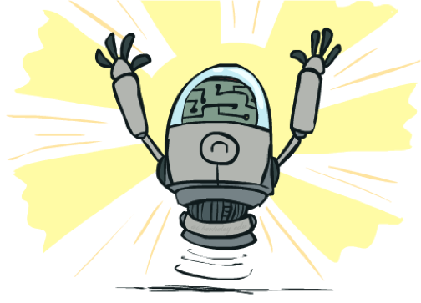
What Can AI Do?
Quiz: Which of the following can be done at present?
Play a decent game of table tennis?
Play a decent game of Jeopardy?
Drive safely along a curving mountain road?
Drive safely along Telegraph Avenue?
Buy a week's worth of groceries on the web?
Buy a week's worth of groceries at Berkeley Bowl?
Discover and prove a new mathematical theorem?
Converse successfully with another person for an hour?
Perform a surgical operation?
Put away the dishes and fold the laundry?
Translate spoken Chinese into spoken English in real time?
Write an intentionally funny story?

Slide 11
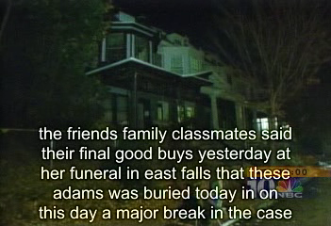
Natural Language
Speech technologies (e.g. Siri)
Automatic speech recognition (ASR)
Text-to-speech synthesis (TTS)
Dialog systems
Demo: NLP – ASR tvsample.avi
Notes:
NLP – ASR tvsample.avi

Slide 12
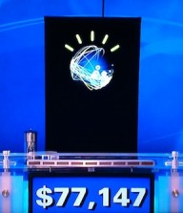
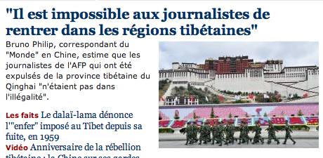
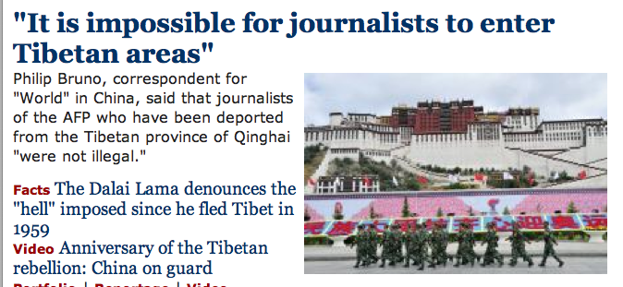
Natural Language
Speech technologies (e.g. Siri)
Automatic speech recognition (ASR)
Text-to-speech synthesis (TTS)
Dialog systems
Language processing technologies
Question answering
Machine translation
Web search
Text classification, spam filtering, etc…

Slide 13
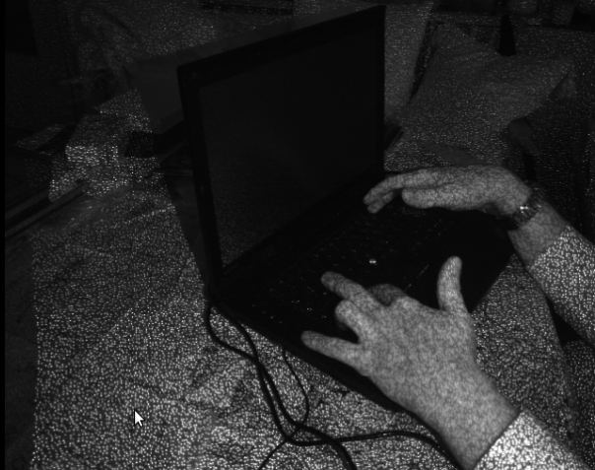
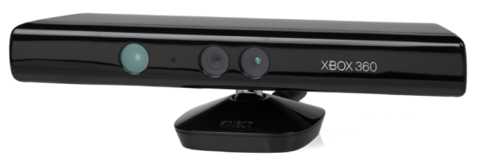
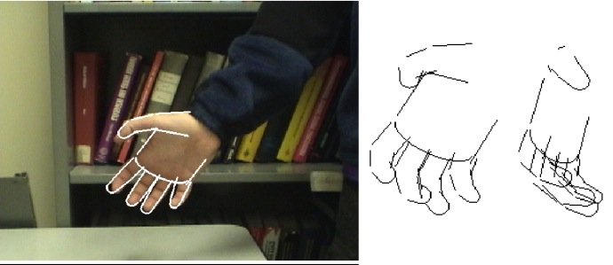
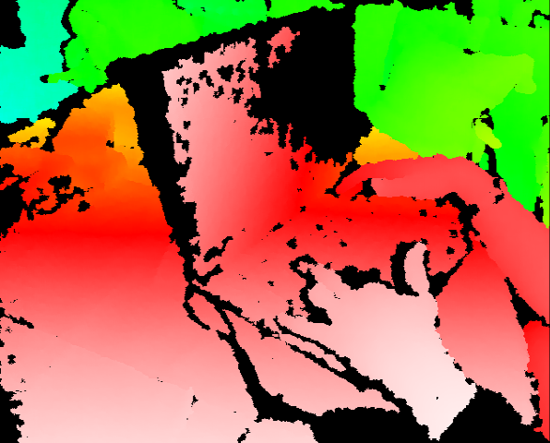
Vision (Perception)
Object and face recognition
Scene segmentation
Image classification
Demo1: VISION – lec_1_t2_video.flv
Images from Erik Sudderth (left), wikipedia (right)
Demo2: VISION – lec_1_obj_rec_0.mpg

Slide 14
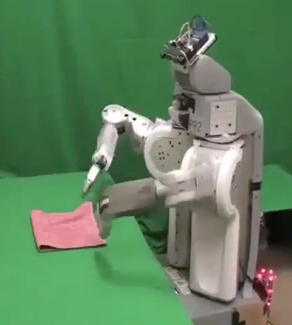
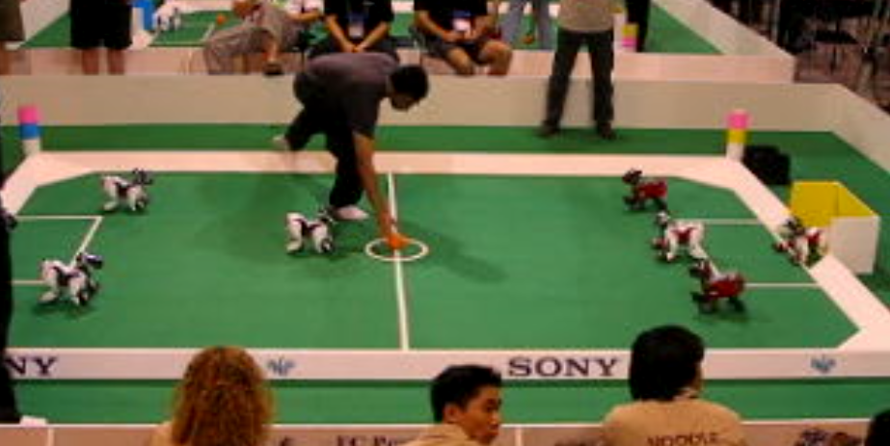
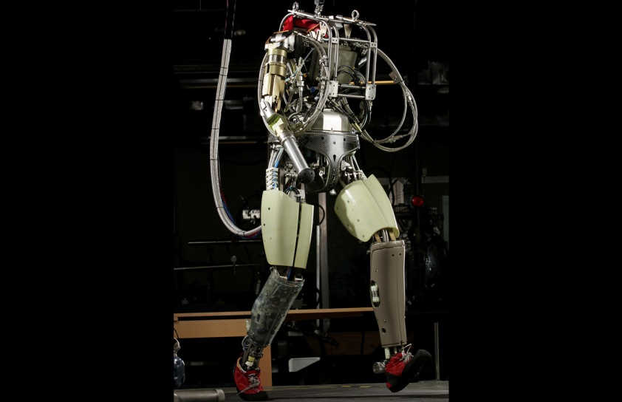
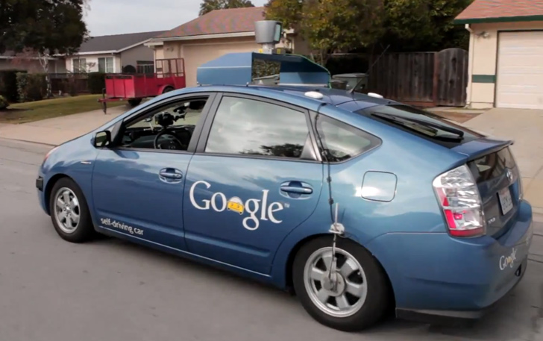
Robotics
Demo 1: ROBOTICS – soccer.avi
Demo 4: ROBOTICS – laundry.avi
Demo 2: ROBOTICS – soccer2.avi
Demo 5: ROBOTICS – petman.avi
Demo 3: ROBOTICS – gcar.avi
Robotics
Part mech. eng.
Part AI
Reality much
harder than
simulations!
Technologies
Vehicles
Rescue
Soccer!
Lots of automation…
Images from UC Berkeley, Boston Dynamics, RoboCup, Google

Slide 15
Logic
Logical systems
Theorem provers
NASA fault diagnosis
Question answering
Methods:
Deduction systems
Constraint satisfaction
Satisfiability solvers (huge advances!)
Image from Bart Selman

Slide 16
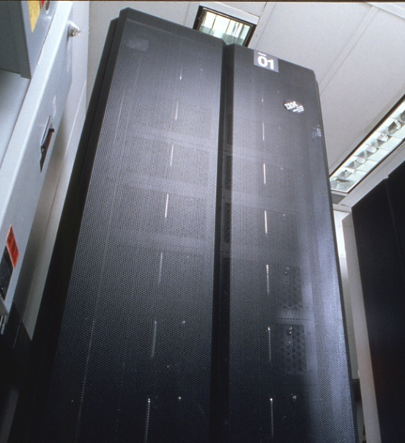
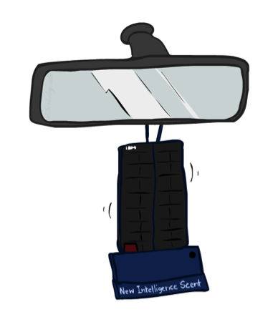
Game Playing
Classic Moment: May, '97: Deep Blue vs. Kasparov
First match won against world champion
“Intelligent creative” play
200 million board positions per second
Humans understood 99.9 of Deep Blue's moves
Can do about the same now with a PC cluster
Open question:
How does human cognition deal with the
search space explosion of chess?
Or: how can humans compete with computers at all??
1996: Kasparov Beats Deep Blue
“I could feel --- I could smell --- a new kind of intelligence across the table.”
1997: Deep Blue Beats Kasparov
“Deep Blue hasn't proven anything.”
Huge game-playing advances recently, e.g. in Go!
Text from Bart Selman, image from IBM’s Deep Blue pages
Notes:
Yeah, Kasparov comment probably says more about humans than about computers

Slide 17

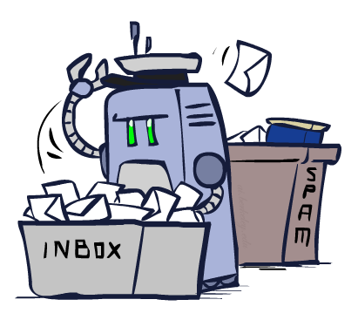
Decision Making
Applied AI involves many kinds of automation
Scheduling, e.g. airline routing, military
Route planning, e.g. Google maps
Medical diagnosis
Web search engines
Spam classifiers
Automated help desks
Fraud detection
Product recommendations
… Lots more!
Notes:
All applications can be thought of as decision making or useful sub-components of decision making

Slide 18
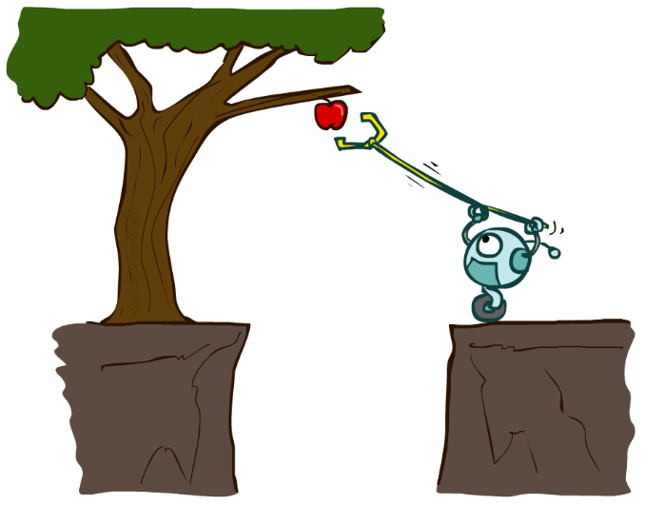
Designing Rational Agents
An agent is an entity that perceives and acts.
A rational agent selects actions that maximize its (expected) utility.
Characteristics of the percepts, environment, and action space dictate techniques for selecting rational actions
Sensors
Agent
Percepts
Environment
?
Actuators
Actions

Slide 19
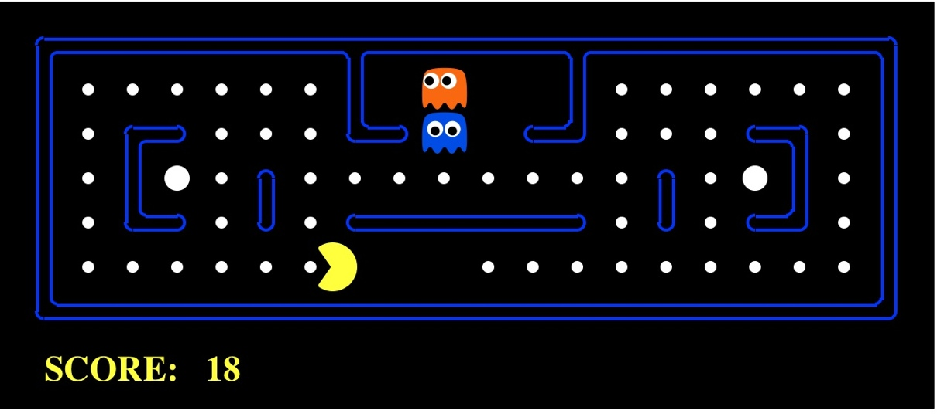
Pac-Man as an Agent
Agent
Environment
Sensors
Percepts
?
Actuators
Actions
Pac-Man is a registered trademark of Namco-Bandai Games, used here for educational purposes
Demo1: pacman-l1.mp4 or L1D2
Notes:
L1D2 =
python demos.py
Select Lecture 1 → select demo 2

Slide 20
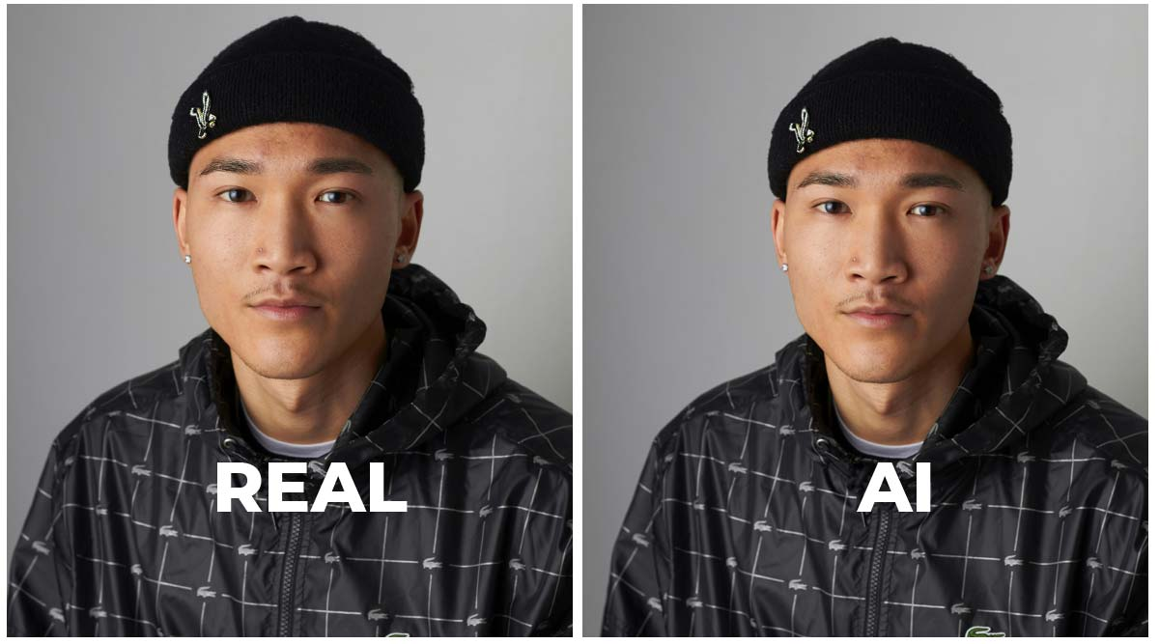
Avatar Making
Recent News: After Klarna, Zoom’s CEO also uses an AI avatar on quarterly call
Behind the Scene:
Talking photo
Match audio with mouth
Streaming avatar
Throughout: Applications
Virtual meeting, education, social media, etc

